Slide 2
Comparing two objects
Which is longer?
Which is shorter?

Slide 3
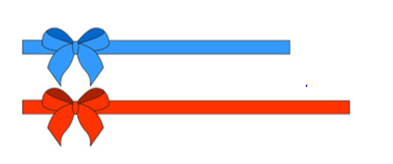
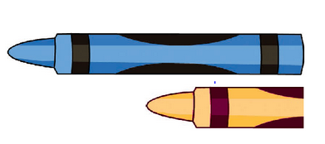

Slide 4
Comparing three or more object objects

Slide 5
